Slide 1


Slide 2


This workshop

Slide 3
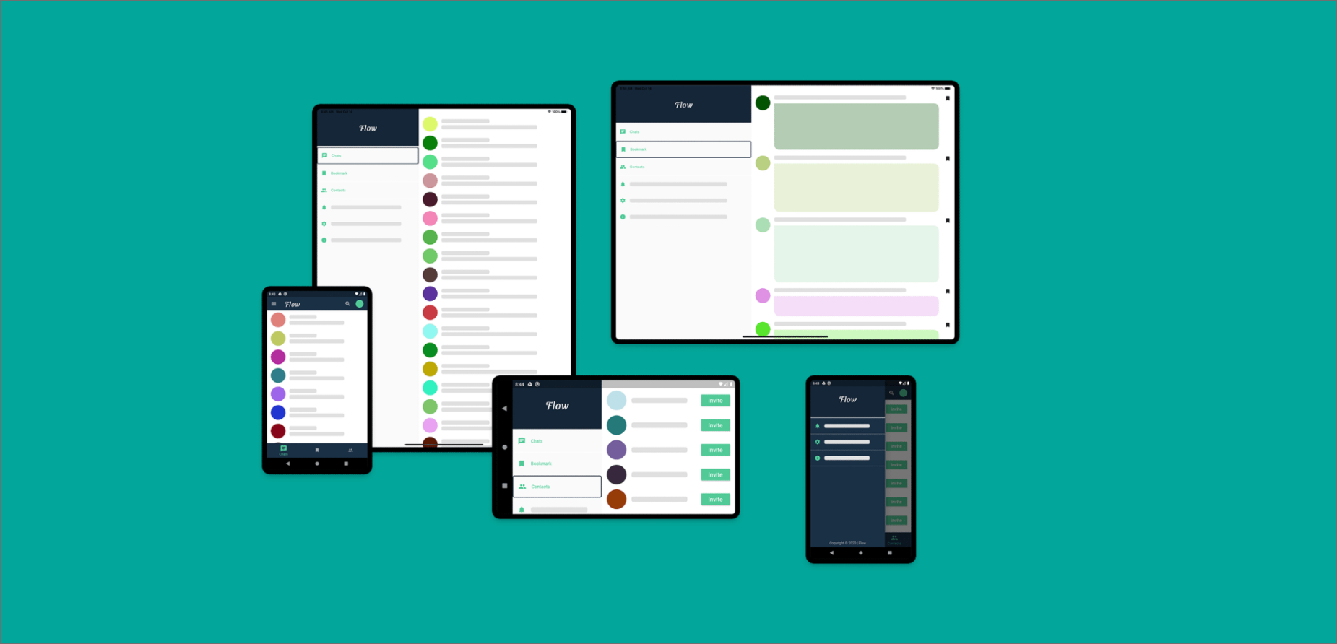
Lets Explore

Slide 4
Lets Explore

Slide 5
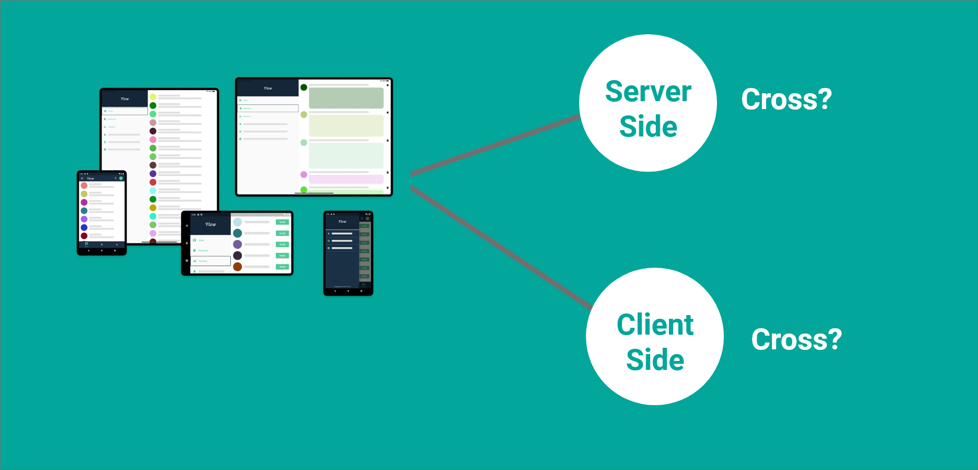
Lets Explore

Slide 6
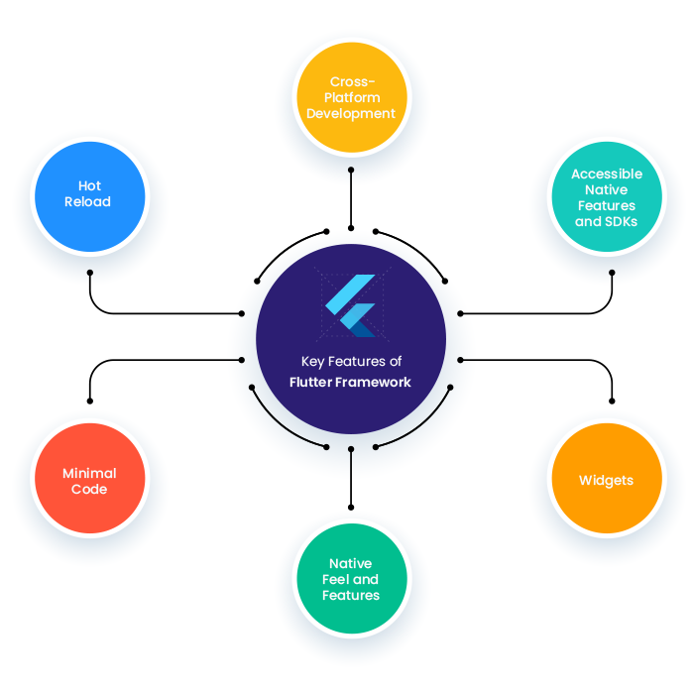
Lets Explore

Slide 7
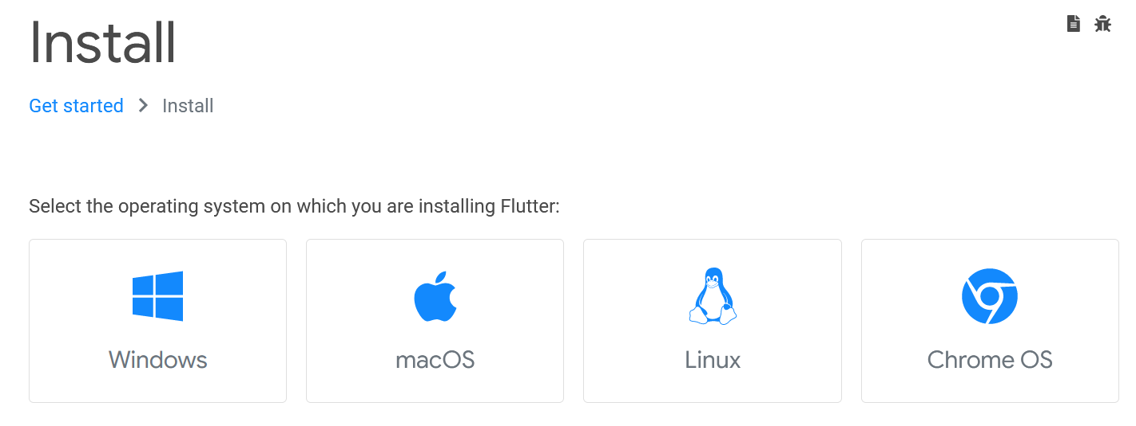
Flutter Installation

Slide 8

The Primary IDE
Get the official Integrated
Development Environment (IDE)
for Android app development.

Slide 9

The IDE

Slide 10

The Primary IDE

Slide 11

Other’s Environment

Slide 12
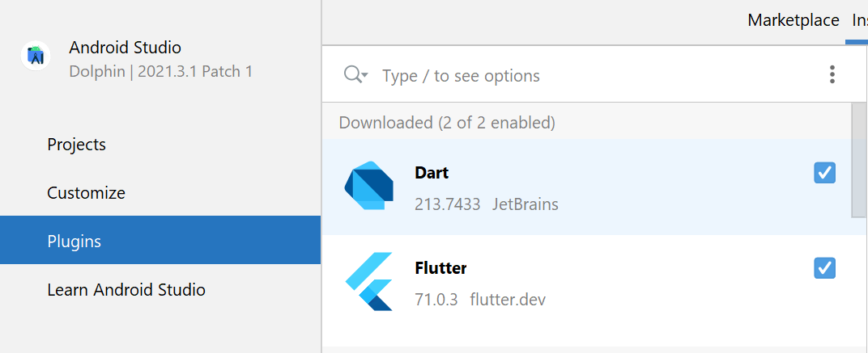
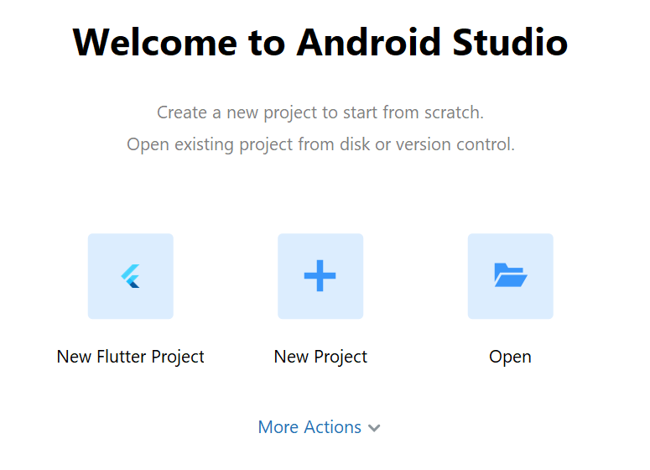
Install Flutter Extensions

Slide 13
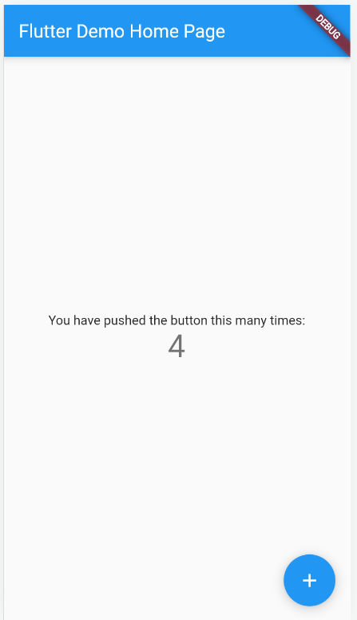
Create & Run Your First Flutter App

Slide 14
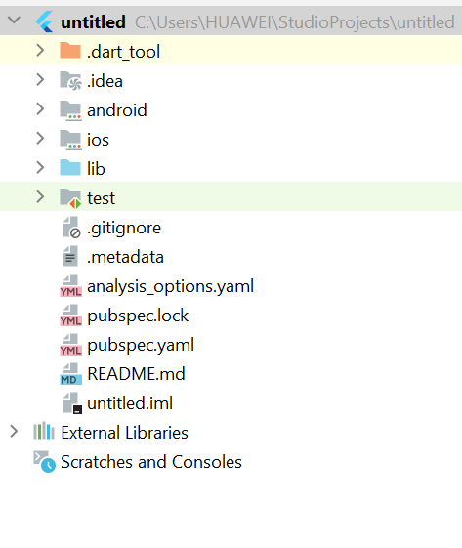
Flutter Project Structure
.idea:
This folder is at the very top of the project structure.
Holds the configuration for Android Studio.
It doesn't matter because we are not going to work with.
So that the content of this folder can be ignored.
.android:
This folder holds a complete Android project
Used when you build the Flutter application for Android
When the Flutter code is compiled into the native code
It will get injected into this Android project
That the result is a native Android application

Slide 15
Flutter Project Structure
.ios:
This folder holds a complete Mac project
used when you build the Flutter application for iOS
When the Flutter code is compiled into the native code
It will get injected into this iOS project
that the result is a native iOS application
Building a Flutter application for iOS is only possible when you are working on macOS

Slide 16
Flutter Project Structure
lib:
It is an essential folder, which stands for the library
It is a folder where we will do our 99 percent of project work
Inside the lib folder, we will find the Dart files which contain the code of our Flutter application
By default, this folder contains the file main.dart, which is the entry file of the Flutter application.

Slide 17
Flutter Project Structure
test:
This folder contains a Dart code,
Which is written for the Flutter application.
Perform the automated test when building the app.
It won't be too important for us here.

Slide 18
Flutter Project Structure
.gitignore:
It is a text file containing a list of files, file extensions, and folders
that tells Git which files should be ignored in a project.
Git is a version-control file for tracking changes in source

Slide 19
Flutter Project Structure
.metadata:
It is an auto-generated file by the flutter tools.
Used to track the properties of the Flutter project.
This file performs the internal tasks.
So you do not need to edit the content manually at any time.

Slide 20
Flutter Project Structure
pubspec.yaml:
It is the project's configuration file that will use a lot during working with the Flutter project. It allows you how your application works. This file contains-
Project general settings such as name
Description, and version of the project.
Project dependencies.
Project assets (e.g., images).

Slide 21
Flutter Project Structure
pubspec.lock:
It is an auto-generated file based on the .yaml file.
It holds more detail setup about all dependencies.

Slide 22

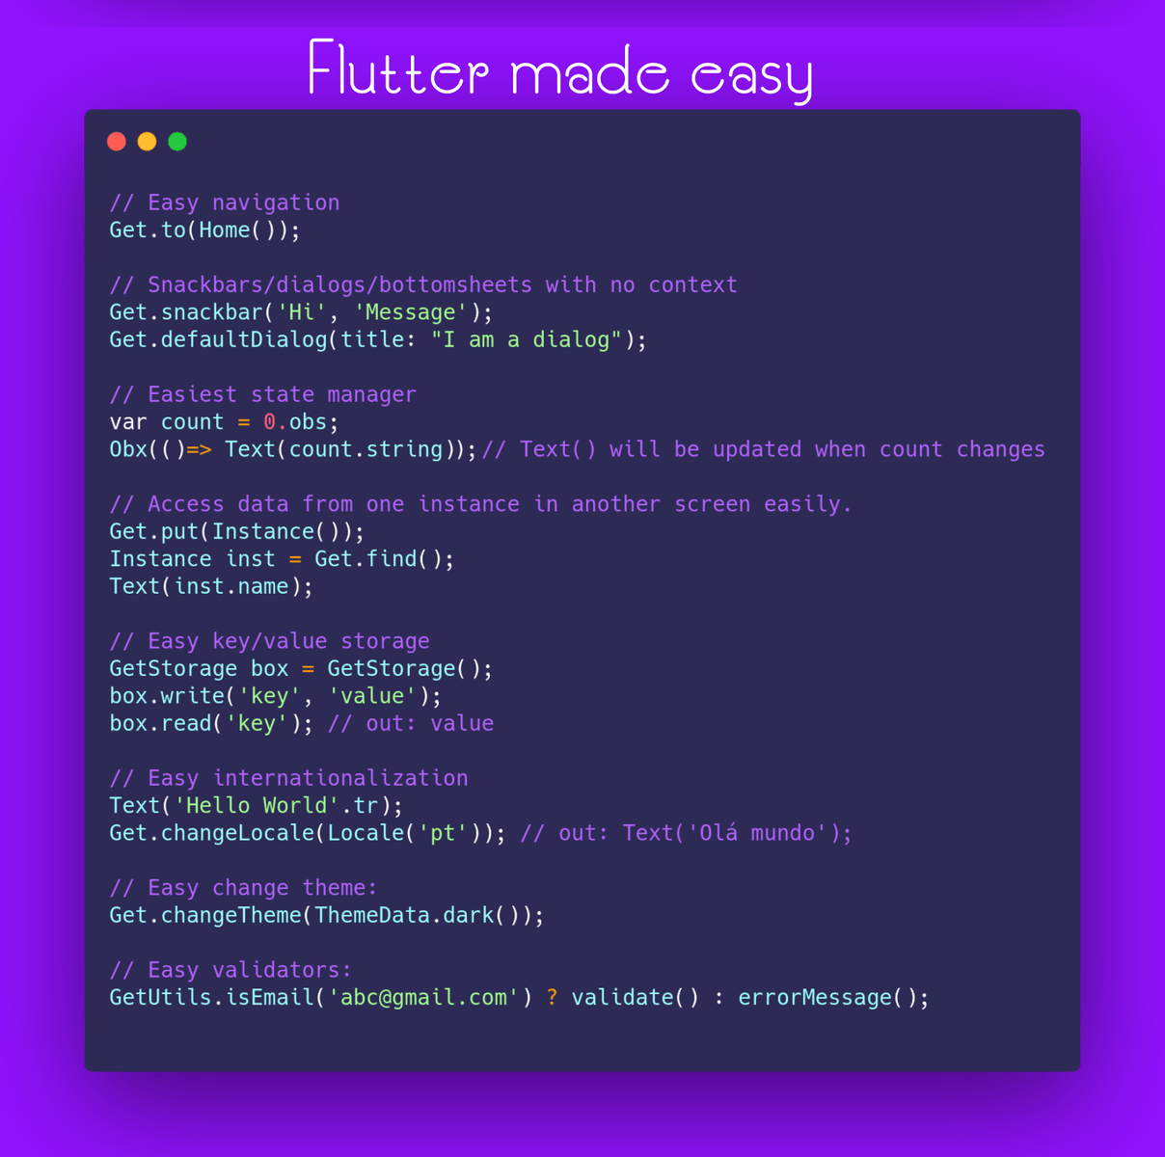
Essential Libraries
Getx

Slide 23
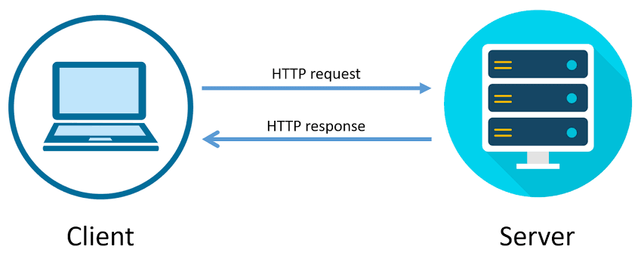
Essential Libraries
HTTP

Slide 24
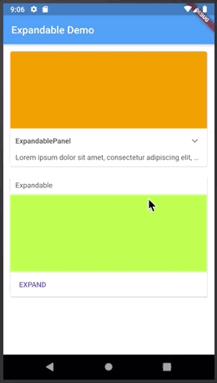
Essential Libraries
Expandable

Slide 25
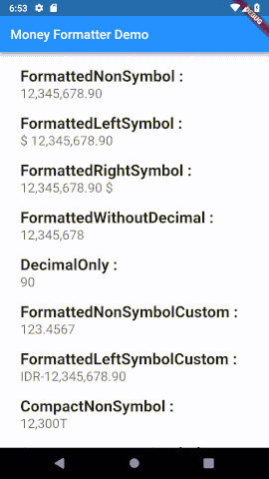
Essential Libraries
Money
Formatter

Slide 26
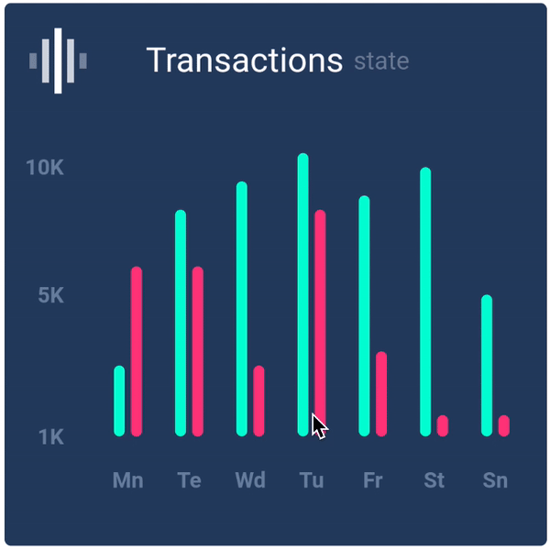
Essential Libraries
Flutter
Chart

Slide 27
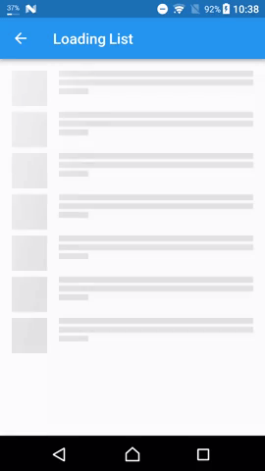
Essential Libraries
Flutter
Shimmer

Slide 28
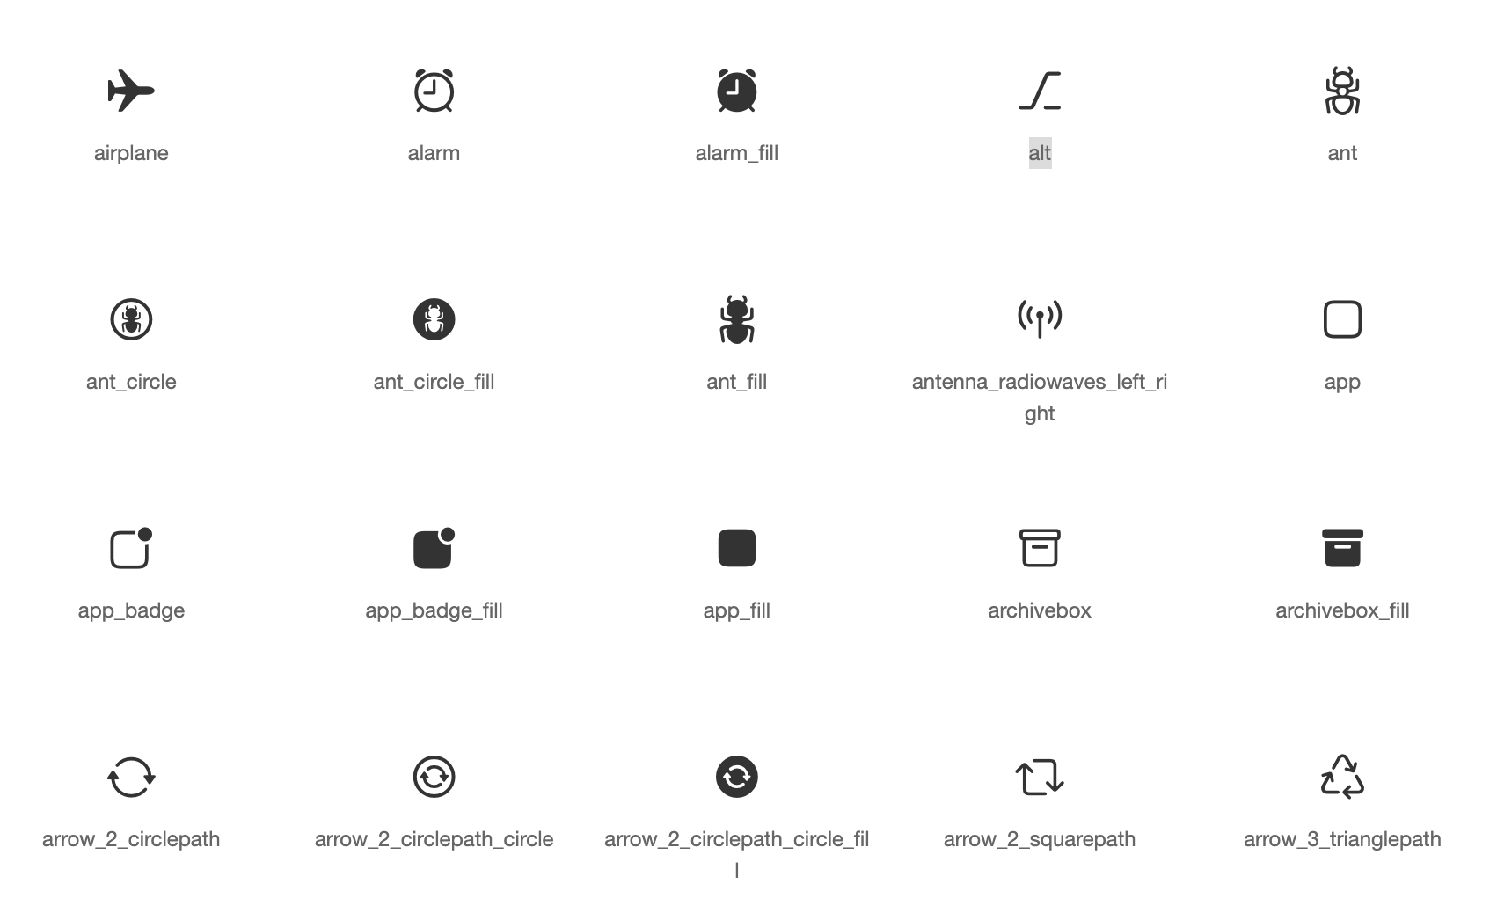
Essential Libraries
Flutter
Fontawesome

Slide 29
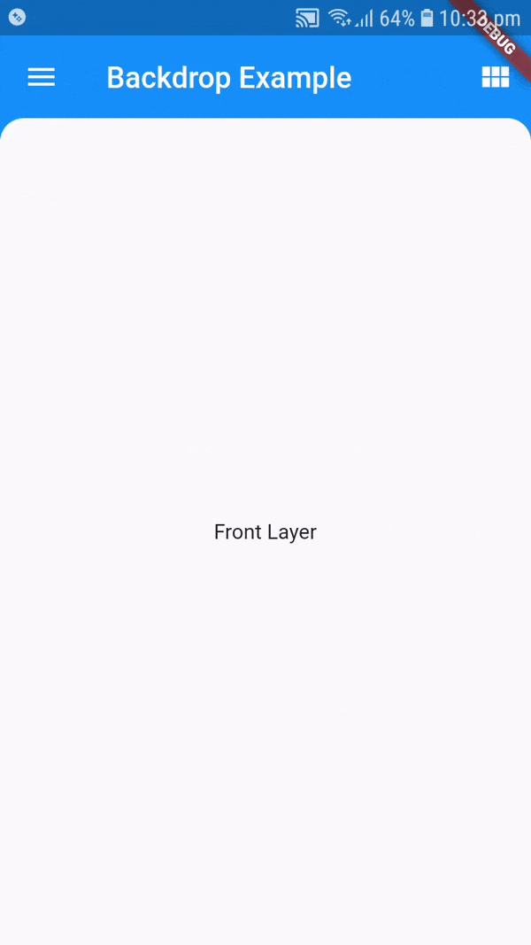
Essential Libraries
Backdrop

Slide 30

Essential Libraries
Intro Slider

Slide 31

Essential Libraries
Bottom
Navy
Bar

Slide 32

Essential Libraries
Local
Auth

Slide 33
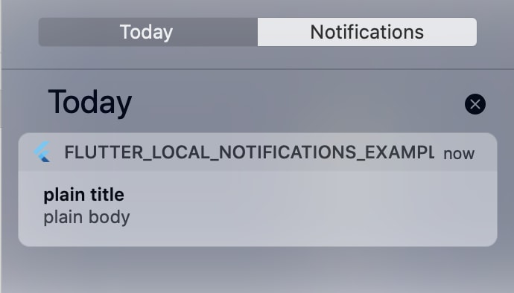
Essential Libraries
Local
Notifications

Slide 34
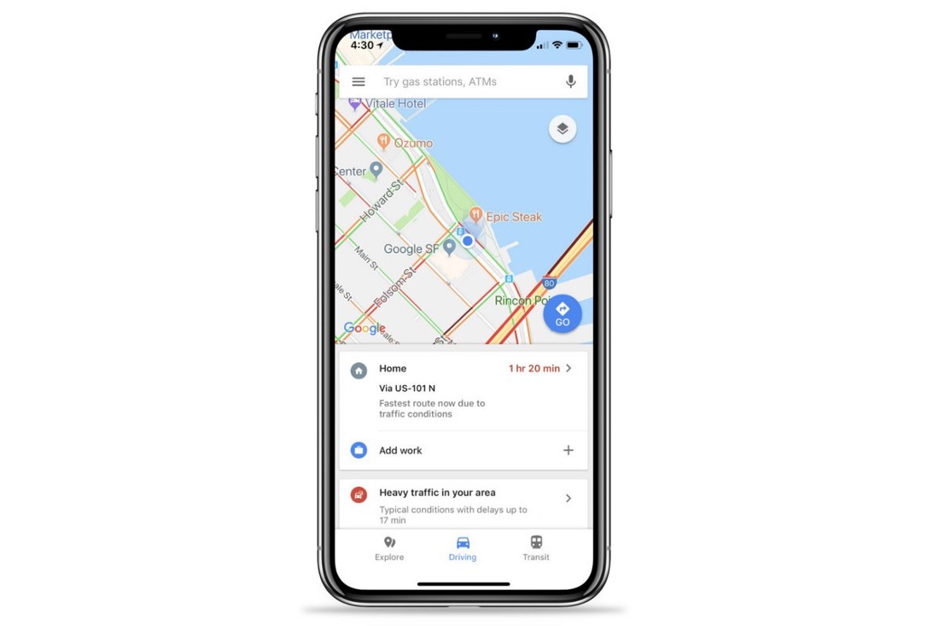
Essential Libraries
Google
Maps
flutter

Slide 35
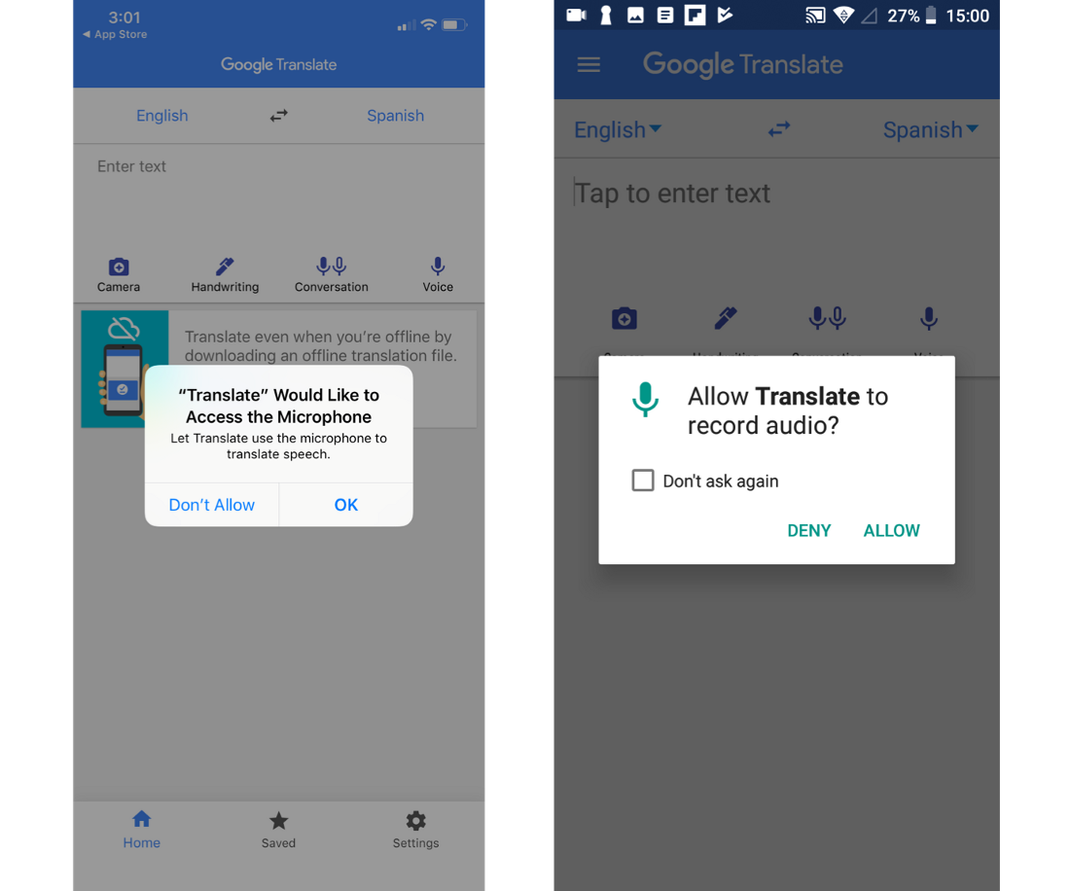
Essential Libraries
Permission
handler

Slide 36
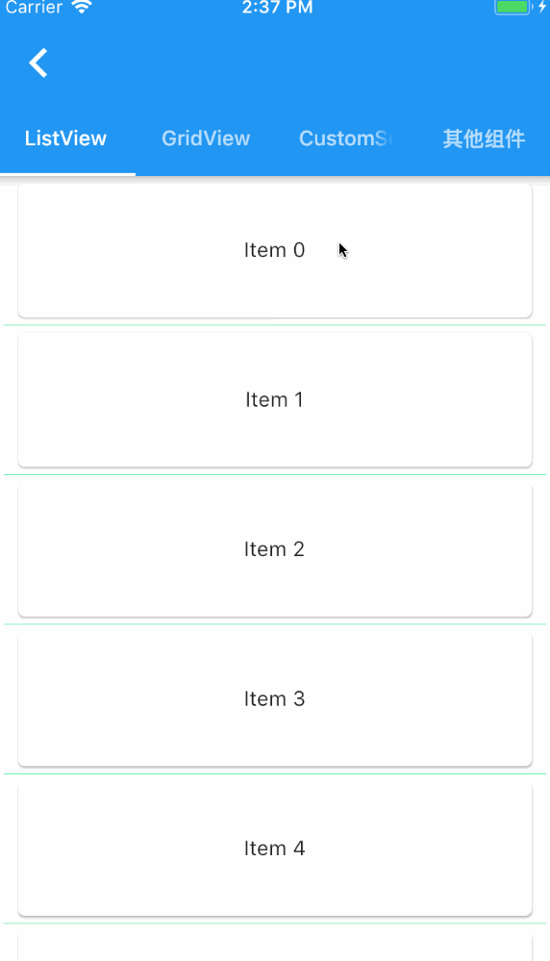
Essential Libraries
Pull
refresh

Slide 37
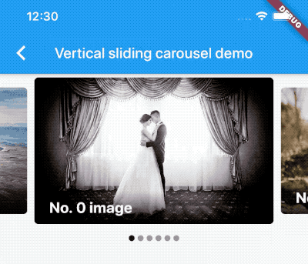
Essential Libraries
Carousel
Slider

Slide 38

Essential Libraries
Flutter
Tensorflow

